Slide 1

Advanced blueprint
Example with Kafka
Michael COURCY
Solution Architect

Slide 2






Kafka
App-Consistent Backup
Application Hooks
Logical DB Capture
Blueprint Extensibility
Managed Data Services
Log and Replica Capture

Slide 3

What’s kafka
Producers
App
App
App
DB
App
Connectors
DB
App
Stream Processors
DB
Kafka Cluster
App
App
App
App
Consumers
Notes:
Kafka is not meant for backup and PIT because it offers a stream where consumer and producer can read and write.
Those producers and consumers feed or read upstream or downstream "classical databases".
Hence the kafka's authors did not design Kafka with durable backup and PIT in mind. The backup should be on downstream or upstream databases.

Slide 4
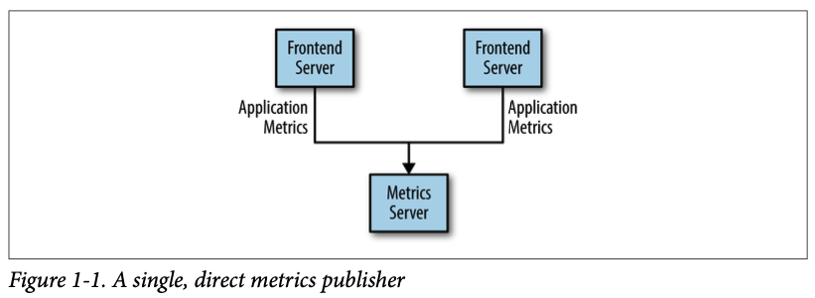
Aggregate data

Slide 5
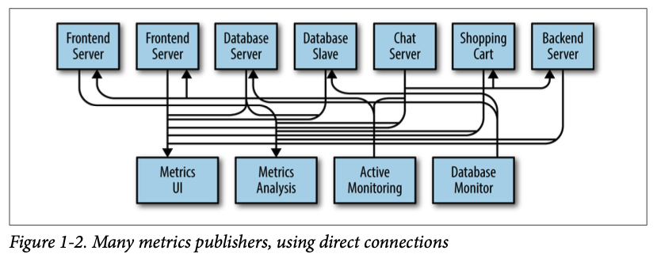
Each individual connection increase technical debt

Slide 6
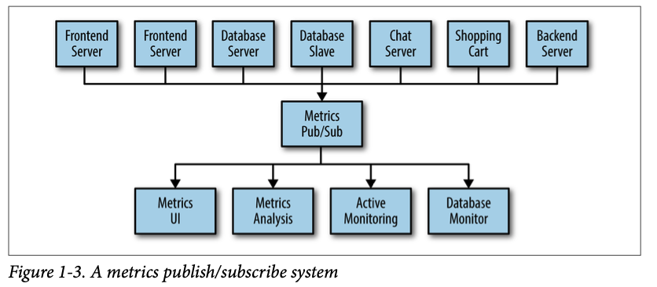
Congrat you’ve built a pub/sub system !

Slide 7
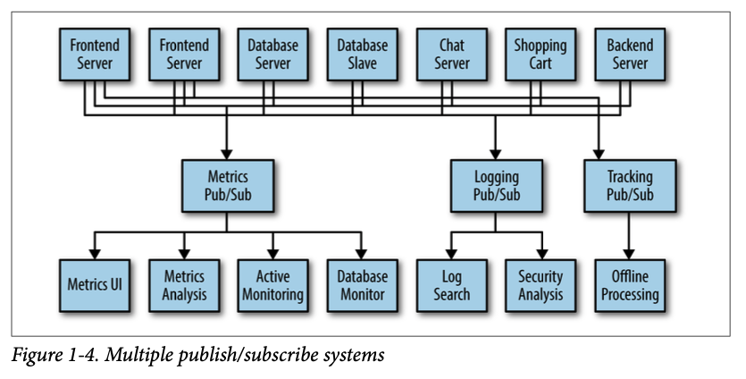
But metrics is not the only topic we need a global solution

Slide 8
Enter Kafka
Producers
App
App
App
DB
App
Connectors
DB
App
Stream Processors
DB
Kafka Cluster
App
App
App
App
Consumers

Slide 9
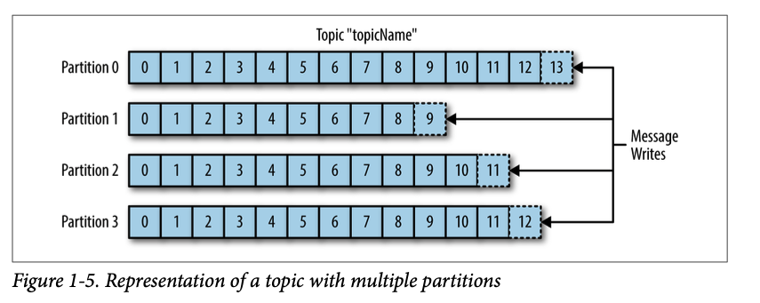
Topic and partitions

Slide 10
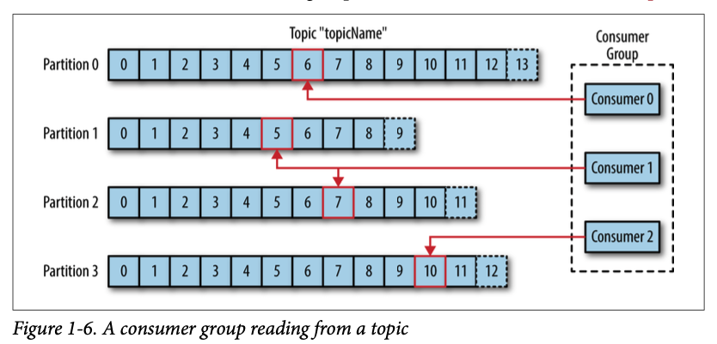
Consumers

Slide 11
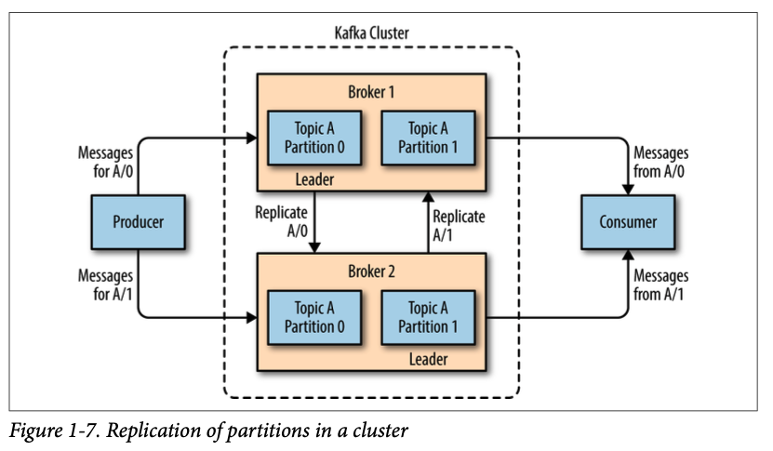
Brokers and Clusters

Slide 12
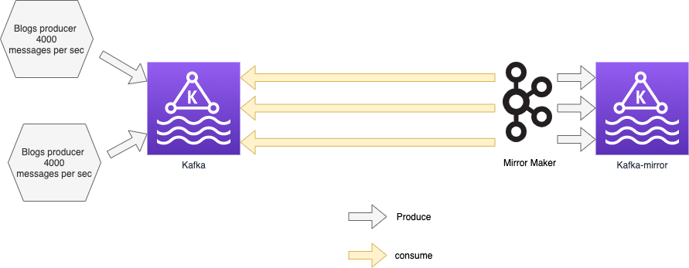
#1 Setup the env : architecture

Slide 13
#2 Setup the env : useful script
recreate_env.sh
count_message_per_seconds.sh
read_last_10_messages.sh
compare_topic.sh
Demo …

Slide 14
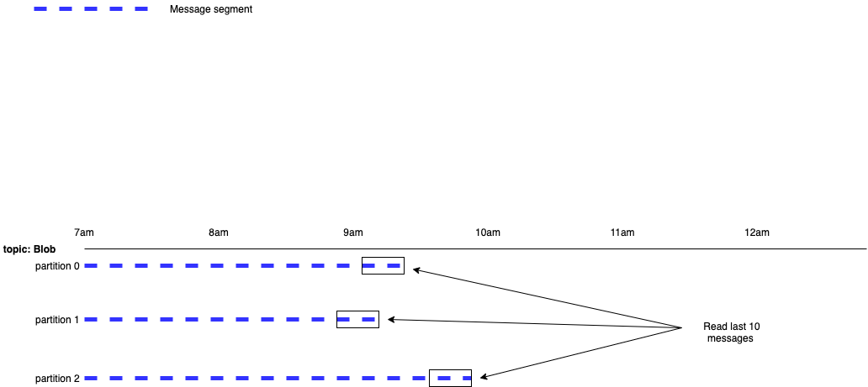
#3 Setup the env : read_last_10_messages

Slide 15
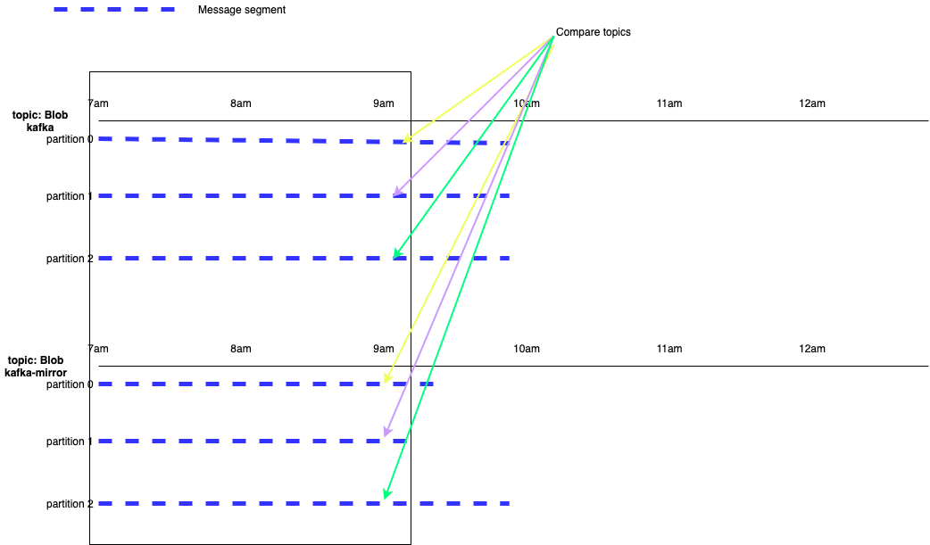
#4 Setup the env : compare_topic

Slide 16
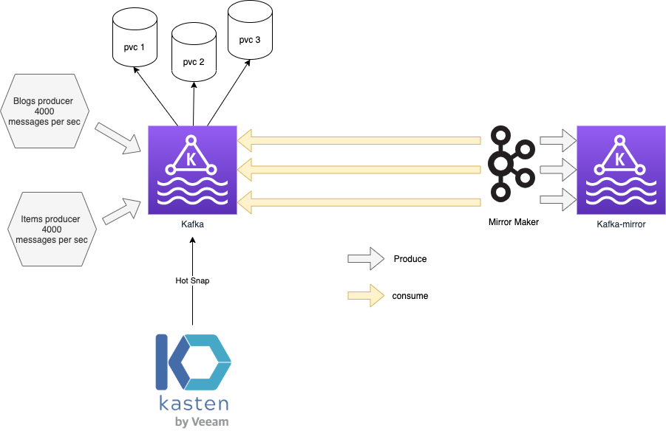
#1 Hot Snapshot

Slide 17
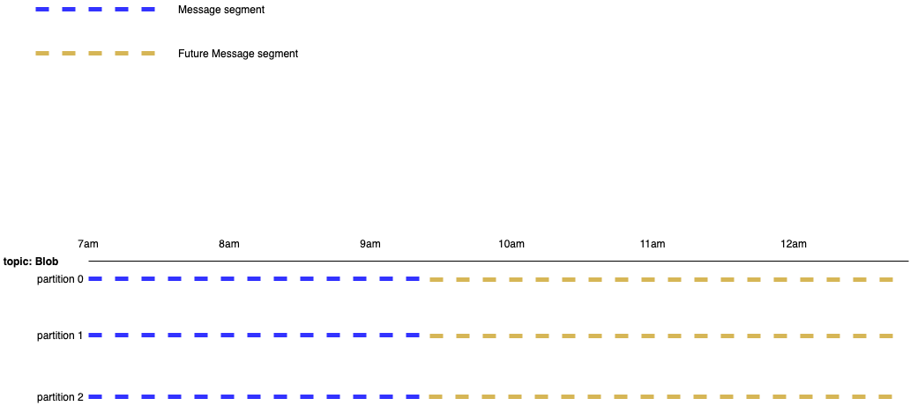
#2 hot snapshot : before snapshot

Slide 18
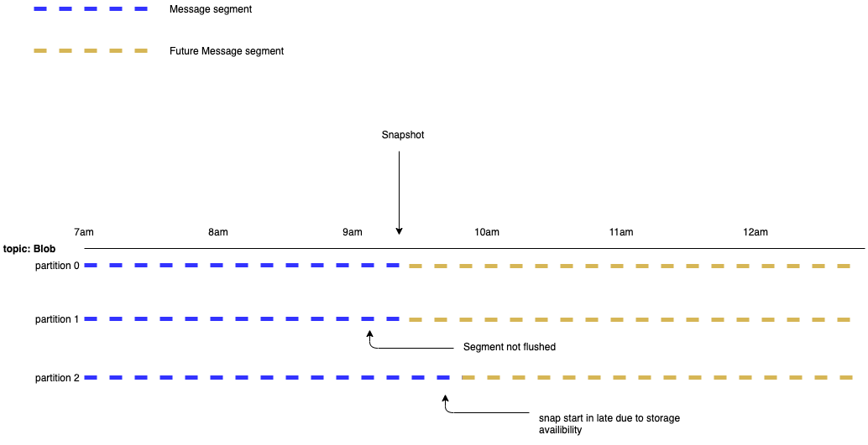
#3 hot snapshot : at snapshot

Slide 19
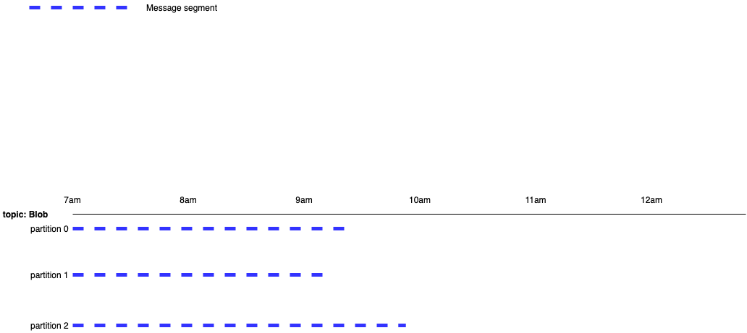
#4 hot snapshot : restored

Slide 20
#5 hot snapshot : conclusion
Head is app unconsistent
However tail is app consistent
Depending of the use case it could be a good choice
Demo …

Slide 21
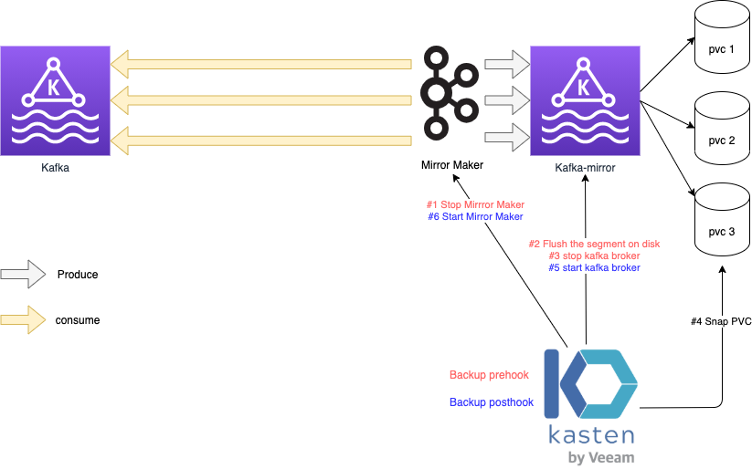
#App Consistent backup + demo

Slide 22
Thank you

